Slide 1
Java
The basics
Sanjeevi R
Sanjeevi_nightwing@yahoo.com

Slide 2
A Simple Program
/*
This is a simple Java program.
Call this file "Example.java".
*/
class Example
{
// Your program begins with a call to main().
public static void main(String args[])
{
System.out.println("This is a simple Java program.");
}
}

Slide 3
Structure of a Java Program
The first thing that you must learn about Java is that the name you give to a source file is very important.
In Java, a source file is officially called a compilation unit. It is a text file that contains one or more class definitions. The Java compiler requires that a source file use the .java filename extension.
In Java, all code must reside inside a class. By convention, the name of that class should match the name of the file that holds the program.

Slide 4
A Closer Look at the First Sample Program
Comments - Java lets you enter a remark into a program’s source file. The contents of a comment are ignored by the compiler. 3 types of comments in java – single line, multi line and documentation comments
Keyword Class - keyword class is used to declare that a new class is being defined. Example is an identifier that is the name of the class.
The main() method - All Java applications begin execution by calling main( ).

Slide 5
The main() method
The public keyword is an access specifier, which allows the programmer to control the visibility of class members.
The keyword static allows main( ) to be called without having to instantiate a particular instance of the class. This is necessary since main( ) is called by the Java Virtual Machine before any objects are made.
The keyword void simply tells the compiler that main( ) does not return a value.
In main( ), there is only one parameter – String args[ ] declares a parameter named args, which is an array of instances of the class String. args receives any command-line arguments present when the program is executed.

Slide 6
A Second Short Program
/*
Here is another short example.
Call this file "Example2.java".
*/
class Example2 {
public static void main(String args[]) {
int num; // this declares a variable called num
num = 100; // this assigns num the value 100
System.out.println("This is num: " + num);
num = num * 2;
System.out.print("The value of num * 2 is ");
System.out.println(num);
}
}

Slide 7
A Closer Look at the Second Sample Program
Variables - variable is a named memory location that may be assigned a value by your program.
The value of a variable may be changed during the execution of the program.

Slide 8
Source file declaration rules
There can be only one public class per source file.
A source file can have multiple non public classes.
The public class name should be the name of the source file as well which should be appended by.java at the end. For example : The class name is public class Employee{} Then the source file should be as Employee.java.
If the class is defined inside a package, then the package statement should be the first statement in the source file.

Slide 9
Source file declaration rules
If import statements are present then they must be written between the package statement and the class declaration. If there are no package statements then the import statement should be the first line in the source file.
Import and package statements will imply to all the classes present in the source file. It is not possible to declare different import and/or package statements to different classes in the source file.
Classes have several access levels and there are different types of classes; abstract classes, final classes, etc.

Slide 10
Packages and imports
Java Package:
In simple, it is a way of categorizing the classes and interfaces. When developing applications in Java, hundreds of classes and interfaces will be written, therefore categorizing these classes is a must as well as makes life much easier.
Import statements:
In Java if a fully qualified name, which includes the package and the class name, is given then the compiler can easily locate the source code or classes. Import statement is a way of giving the proper location for the compiler to find that particular class.
For example, the following line would ask compiler to load all the classes available in directory java_installation/java/io :
import java.io.*;

Slide 11
Data Types
Variables are nothing but reserved memory locations to store values. This means that when you create a variable you reserve some space in memory.
Based on the data type of a variable, the operating system allocates memory and decides what can be stored in the reserved memory. Therefore, by assigning different data types to variables, you can store integers, decimals, or characters in these variables.
There are two data types available in Java:
Primitive Data Types
Reference/Object Data Types

Slide 12
Primitive Data Types
There are eight primitive data types supported by Java.
Primitive data types are predefined by the language and are named by a keyword.

Slide 13
byte
Byte data type is an 8-bit signed two's complement integer.
Minimum value is -128 (-2^7)
Maximum value is 127 (inclusive)(2^7 -1)
Default value is 0
Byte data type is used to save space in large arrays, mainly in place of integers, since a byte is four times smaller than an int.
Example: byte a = 100 , byte b = -50

Slide 14
short
Short data type is a 16-bit signed two's complement integer.
Minimum value is -32,768 (-2^15)
Maximum value is 32,767 (inclusive) (2^15 -1)
Short data type can also be used to save memory as byte data type. A short is 2 times smaller than an int
Default value is 0.
Example: short s = 10000, short r = -20000

Slide 15
int
Int data type is a 32-bit signed two's complement integer.
Minimum value is - 2,147,483,648.(-2^31)
Maximum value is 2,147,483,647(inclusive).(2^31 -1)
Int is generally used as the default data type for integral values unless there is a concern about memory.
The default value is 0.
Example: int a = 100000, int b = -200000

Slide 16
long
Long data type is a 64-bit signed two's complement integer.
Minimum value is -9,223,372,036,854,775,808.(-2^63)
Maximum value is 9,223,372,036,854,775,807 (inclusive). (2^63 -1)
This type is used when a wider range than int is needed.
Default value is 0L.
Example: long a = 100000L, int b = -200000L

Slide 17
float
Float data type is a single-precision 32-bit IEEE 754 floating point.
Float is mainly used to save memory in large arrays of floating point numbers.
Default value is 0.0f.
Example: float f1 = 234.5f

Slide 18
double
double data type is a double-precision 64-bit IEEE 754 floating point.
This data type is generally used as the default data type for decimal values, generally the default choice.
Default value is 0.0d.
Example: double d1 = 123.4

Slide 19
boolean
boolean data type represents one bit of information.
There are only two possible values: true and false.
This data type is used for simple flags that track true/false conditions.
Default value is false.
Example: boolean one = true

Slide 20
char
char data type is a single 16-bit Unicode character.
Minimum value is '\u0000' (or 0).
Maximum value is '\uffff' (or 65,535 inclusive).
Char data type is used to store any character.
Example: char letterA ='A'

Slide 21
Reference Data Types
Reference variables are created using defined constructors of the classes. They are used to access objects. These variables are declared to be of a specific type that cannot be changed. For example, Employee, Puppy etc.
Class objects, and various type of array variables come under reference data type.
Default value of any reference variable is null.
A reference variable can be used to refer to any object of the declared type or any compatible type.
Example: Animal animal = new Animal("giraffe");

Slide 22
Java Literals
A literal is a source code representation of a fixed value. They are represented directly in the code without any computation.
Literals can be assigned to any primitive type variable. For example:
byte a = 68; char a = 'A‘
String literals in Java are specified like they are in most other languages by enclosing a sequence of characters between a pair of double quotes. Examples of string literals are:
"Hello World" "two\nlines" "\"This is in quotes\""

Slide 23
Java Modifiers
Modifiers are keywords that you add to those definitions to change their meanings. The Java language has a wide variety of modifiers, including the following:
Java Access Modifiers
Non Access Modifiers
To use a modifier, you include its keyword in the definition of a class, method, or variable. The modifier precedes the rest of the statement, as in the following examples
public class className { // ... }
private boolean myFlag;
static final double weeks = 9.5;
protected static final int BOXWIDTH = 42;
public static void main(String[] arguments) { // body of method }

Slide 24
Access Control Modifiers
Java provides a number of access modifiers to set access levels for classes, variables, methods and constructors. The four access levels are:
Visible to the package, the default. No modifiers are needed.
Visible to the class only (private).
Visible to the world (public).
Visible to the package and all subclasses (protected).

Slide 25
Non Access Modifiers
Java provides a number of non-access modifiers to achieve many other functionality.
The static modifier for creating class methods and variables
The final modifier for finalizing the implementations of classes, methods, and variables.
The abstract modifier for creating abstract classes and methods.
The synchronized and volatile modifiers, which are used for threads.

Slide 26
Java basic Operators
Java provides a rich set of operators to manipulate variables. We can divide all the Java operators into the following groups:
Arithmetic Operators
Relational Operators
Bitwise Operators
Logical Operators
Assignment Operators
Misc. Operators

Slide 27
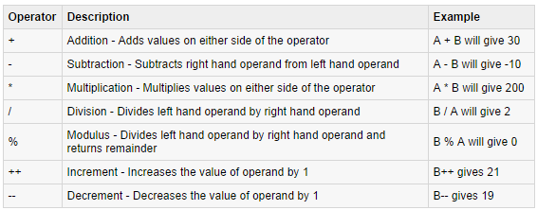
The Arithmetic Operators
Arithmetic operators are used in mathematical expressions in the same way that they are used in algebra. Assume integer variable A holds 10 and variable B holds 20, then:

Slide 28
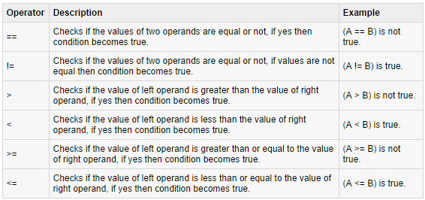
The Relational Operators

Slide 29
The Bitwise Operators
Java defines several bitwise operators, which can be applied to the integer types, long, int, short, char, and byte.
Bitwise operator works on bits and performs bit-by-bit operation. Assume if a = 60; and b = 13; now in binary format they will be as follows:
a = 0011 1100
b = 0000 1101
a&b = 0000 1100
a|b = 0011 1101
a^b = 0011 0001
~a = 1100 0011

Slide 30
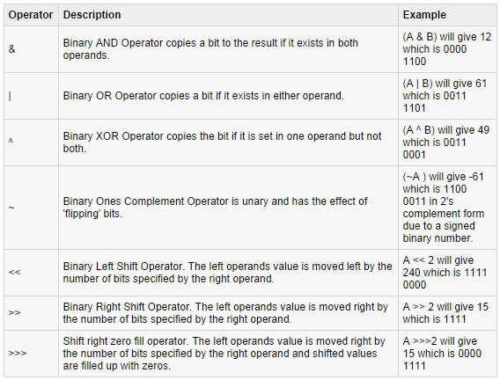
The Bitwise Operators

Slide 31
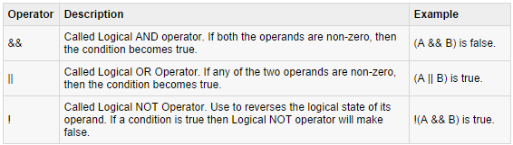
The Logical Operators
Assume Boolean variables A holds true and variable B holds false, then:

Slide 32
The Assignment Operators
…

Slide 33
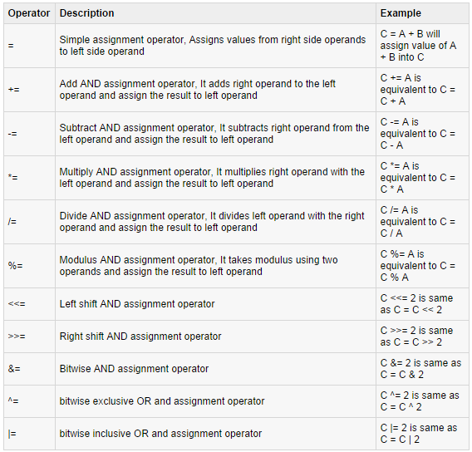
The Assignment Operators

Slide 34
Misc. Operators
Conditional Operator ( ? : ):
Conditional operator is also known as the ternary operator. This operator consists of three operands and is used to evaluate Boolean expressions. The goal of the operator is to decide which value should be assigned to the variable. The operator is written as:
variable x = (expression) ? value if true : value if false

Slide 35
Misc. Operators
instanceof Operator
This operator is used only for object reference variables. The operator checks whether the object is of a particular type(class type or interface type). instanceof operator is wriiten as:
( Object reference variable ) instanceof (class/interface type)
If the object referred by the variable on the left side of the operator passes the IS-A check for the class/interface type on the right side, then the result will be true.

Slide 36
Precedence of Java Operators
Operator precedence determines the grouping of terms in an expression. This affects how an expression is evaluated. Certain operators have higher precedence than others.
For example, x = 7 + 3 * 2; here x is assigned 13, not 20 because operator * has higher precedence than +, so it first gets multiplied with 3*2 and then adds into 7.
The operator precedence table…

Slide 37
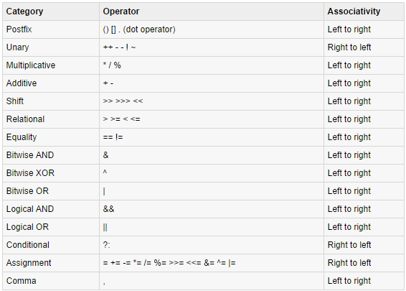

Slide 38
Java – Control Statements

